Slide 1
Describing logic circuit algebraically

Slide 2
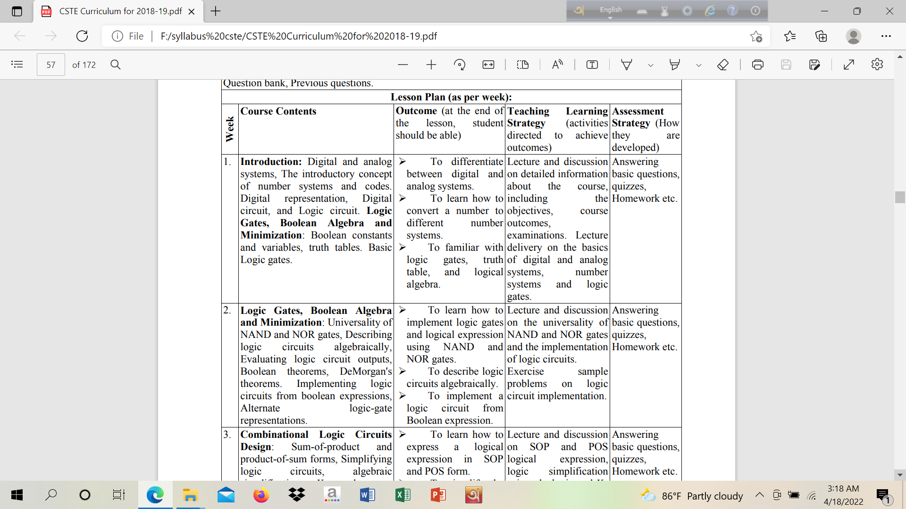

Slide 3
Evaluating logic circuit outputs

Slide 4
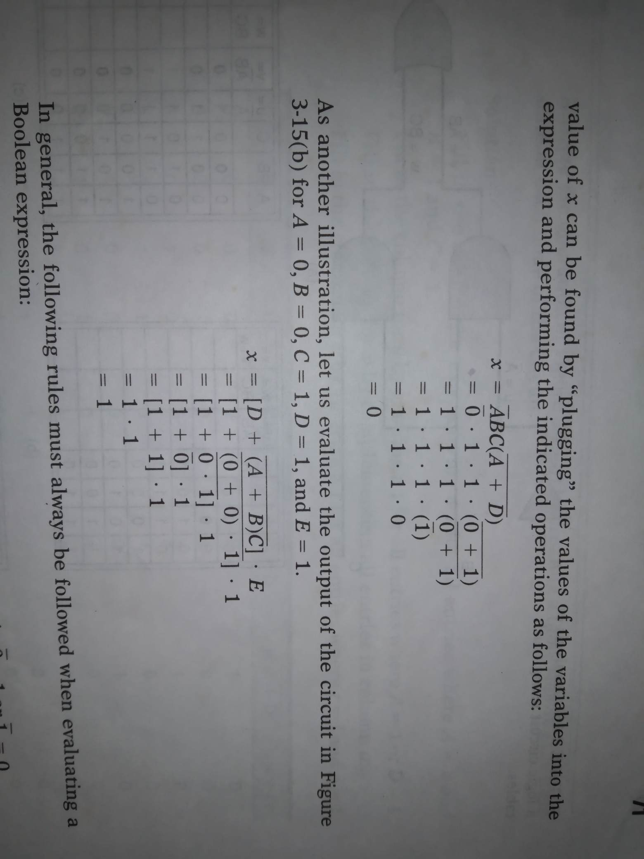
Evaluating logic circuit outputs
If A= 0,
B, C and D= 1

Slide 5
Evaluating logic circuit outputs
If A= 0,
B, C and D= 1

Slide 6
Evaluating logic circuit output
If A and B = 0,
C, D and E= 1

Slide 7
Evaluating logic circuit output

Slide 8
Analysis using a table

Slide 9
Analysis using a table
When you have a combinational logic circuit and you want to know how it works, the best way to analyze it is to use a truth table.

Slide 10
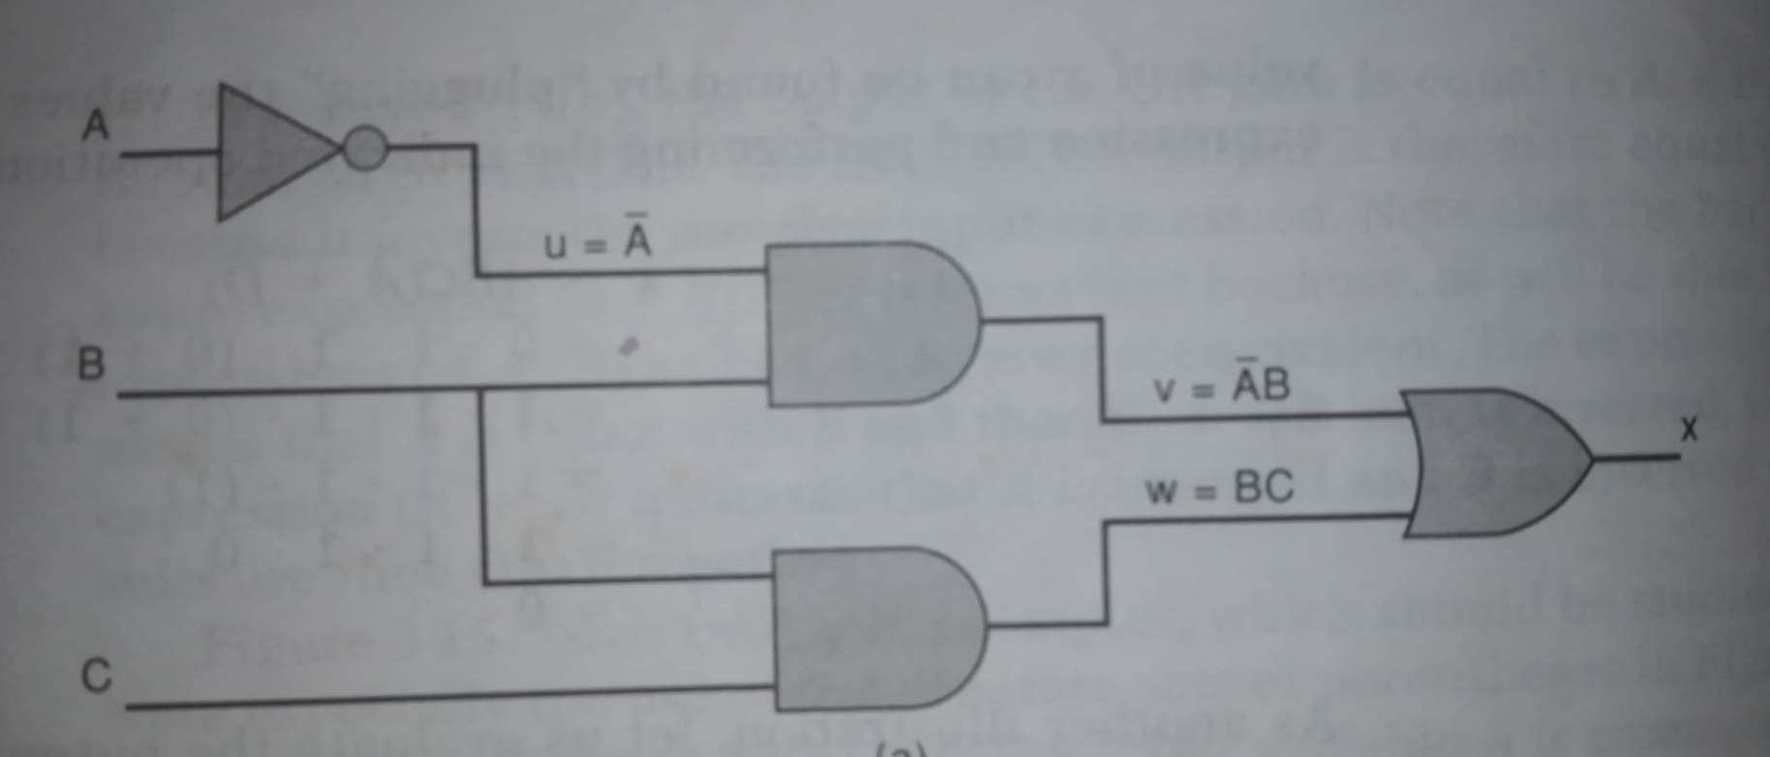
Analysis using a table

Slide 11
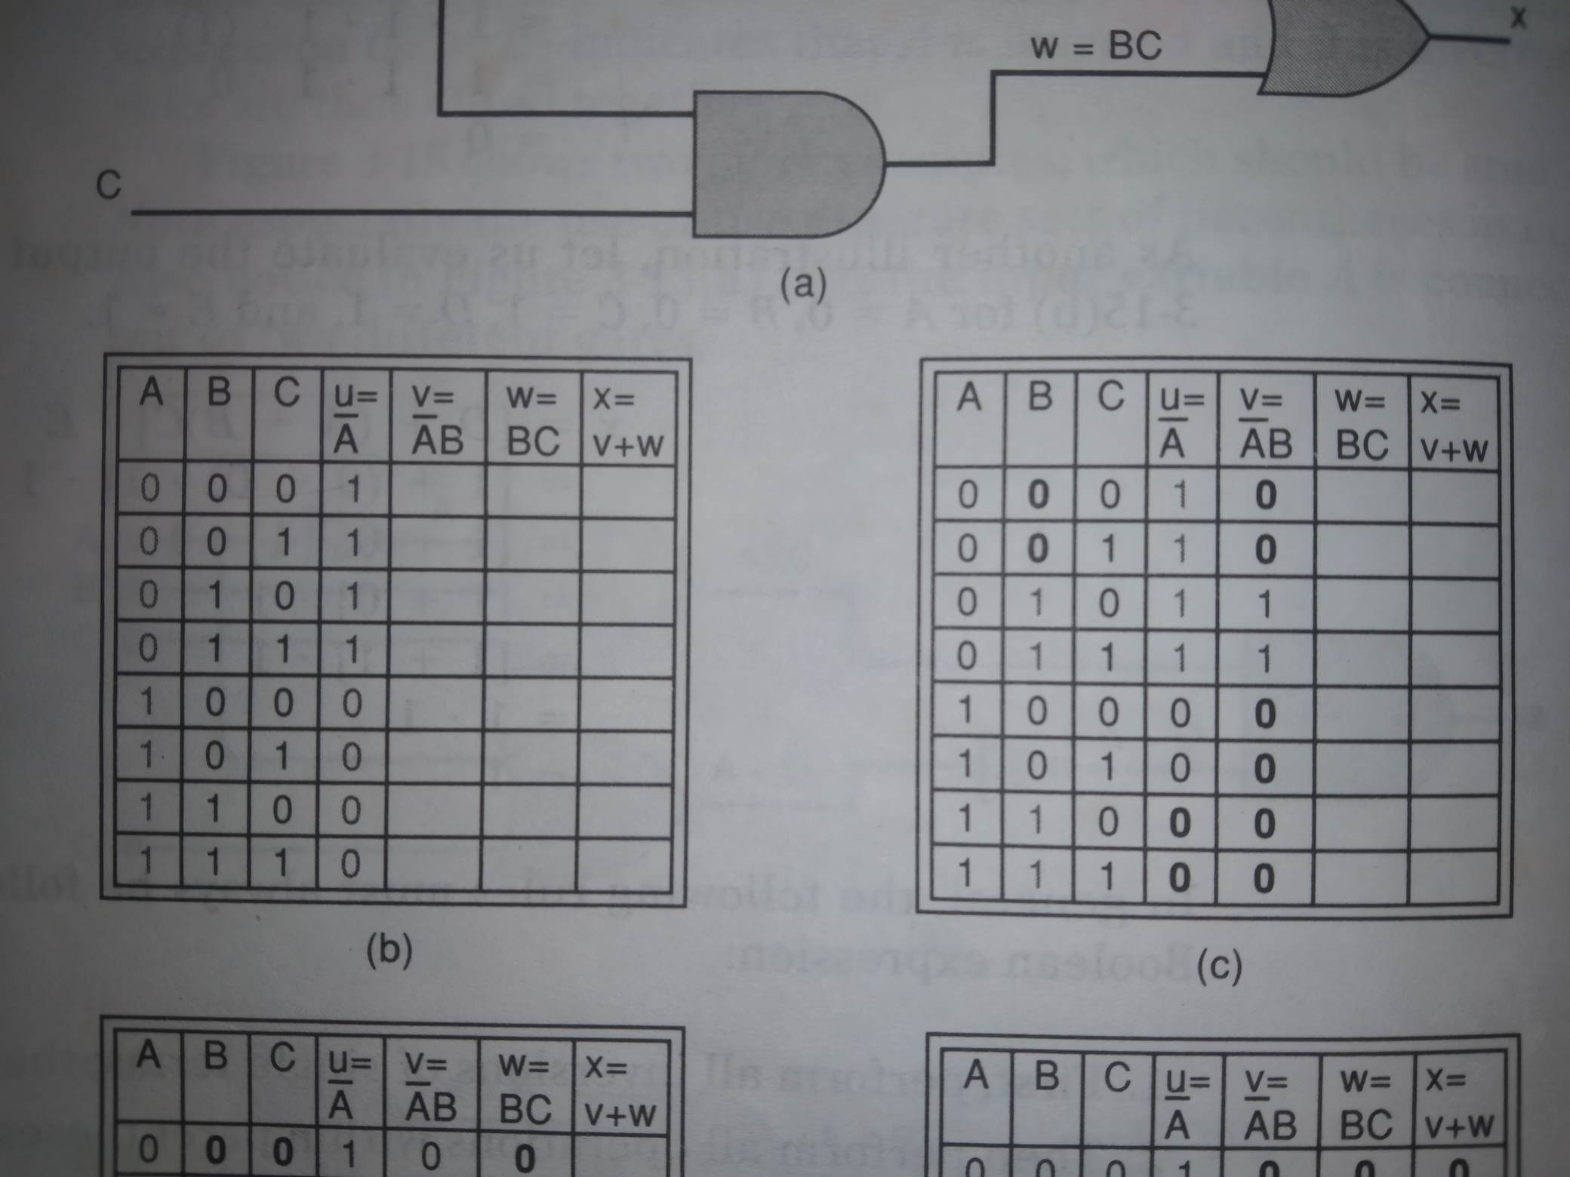
Analysis using a table

Slide 12
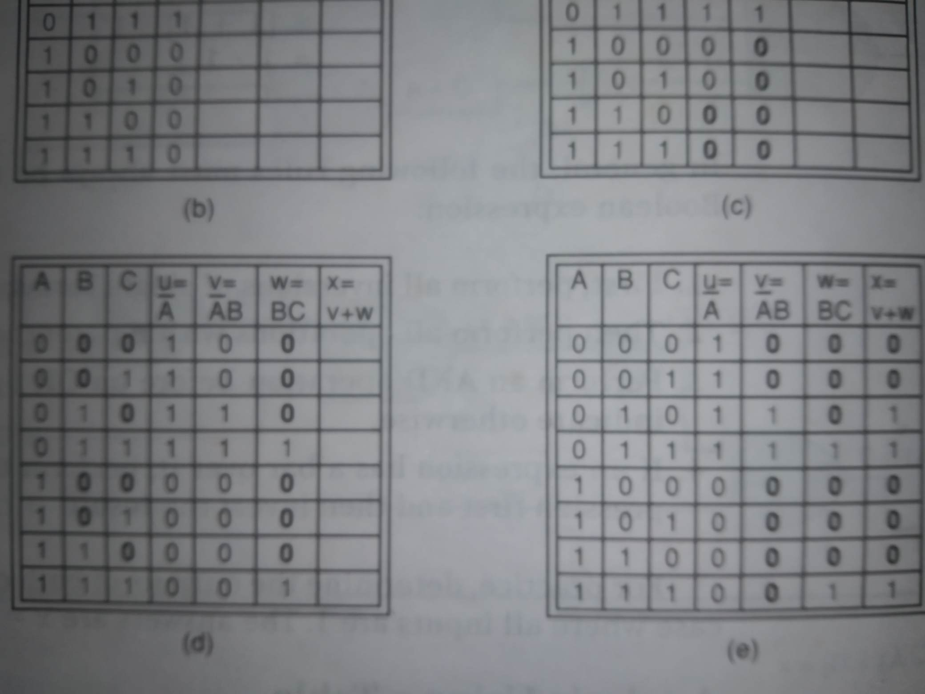
Analysis using a table

Slide 13
Analysis using a table

Slide 14
Implementing circuits from Boolean expressions

Slide 15
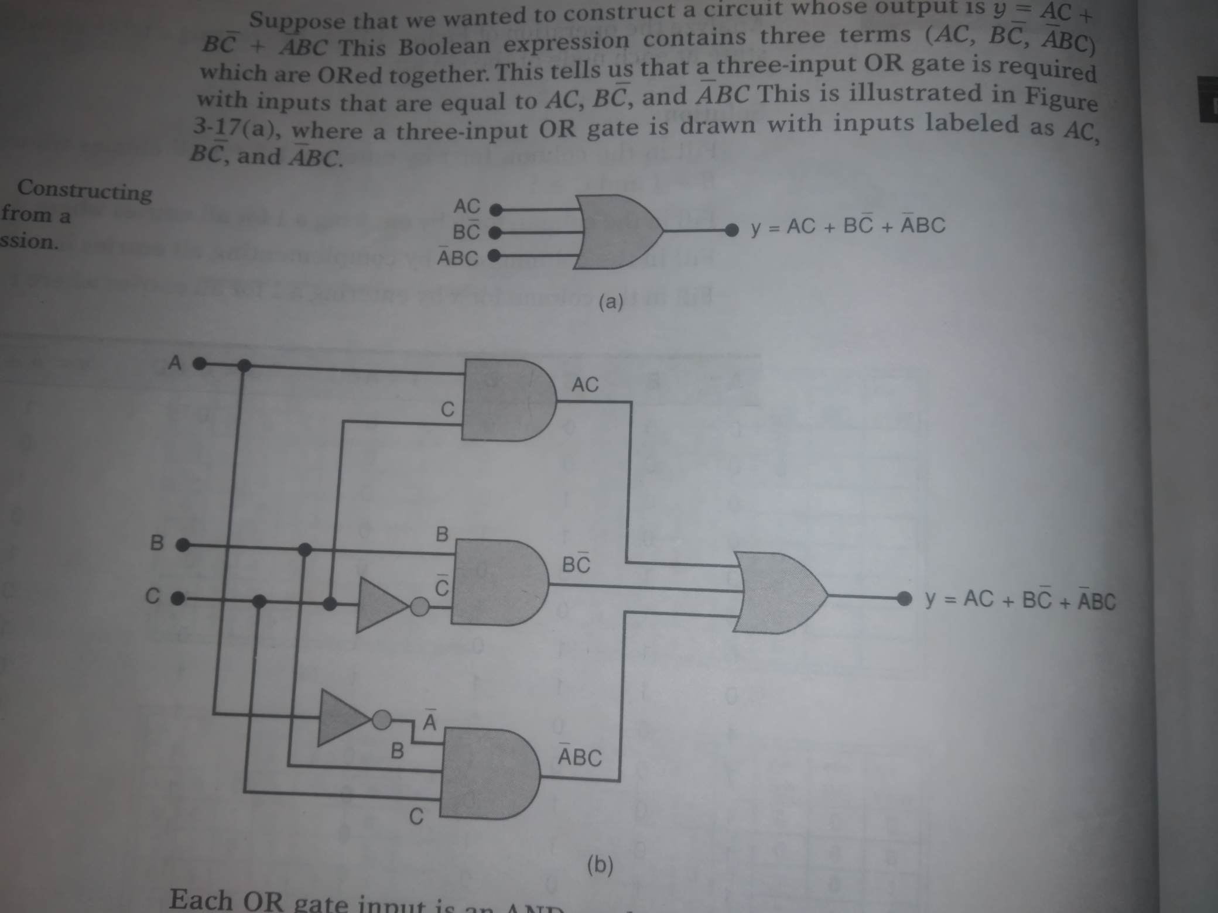
Constructing a logic circuit from a Boolean expression
$$y=AC+B\overline{C}+\overline{A}BC$$

Slide 16
Constructing a logic circuit from a Boolean expression

Slide 17
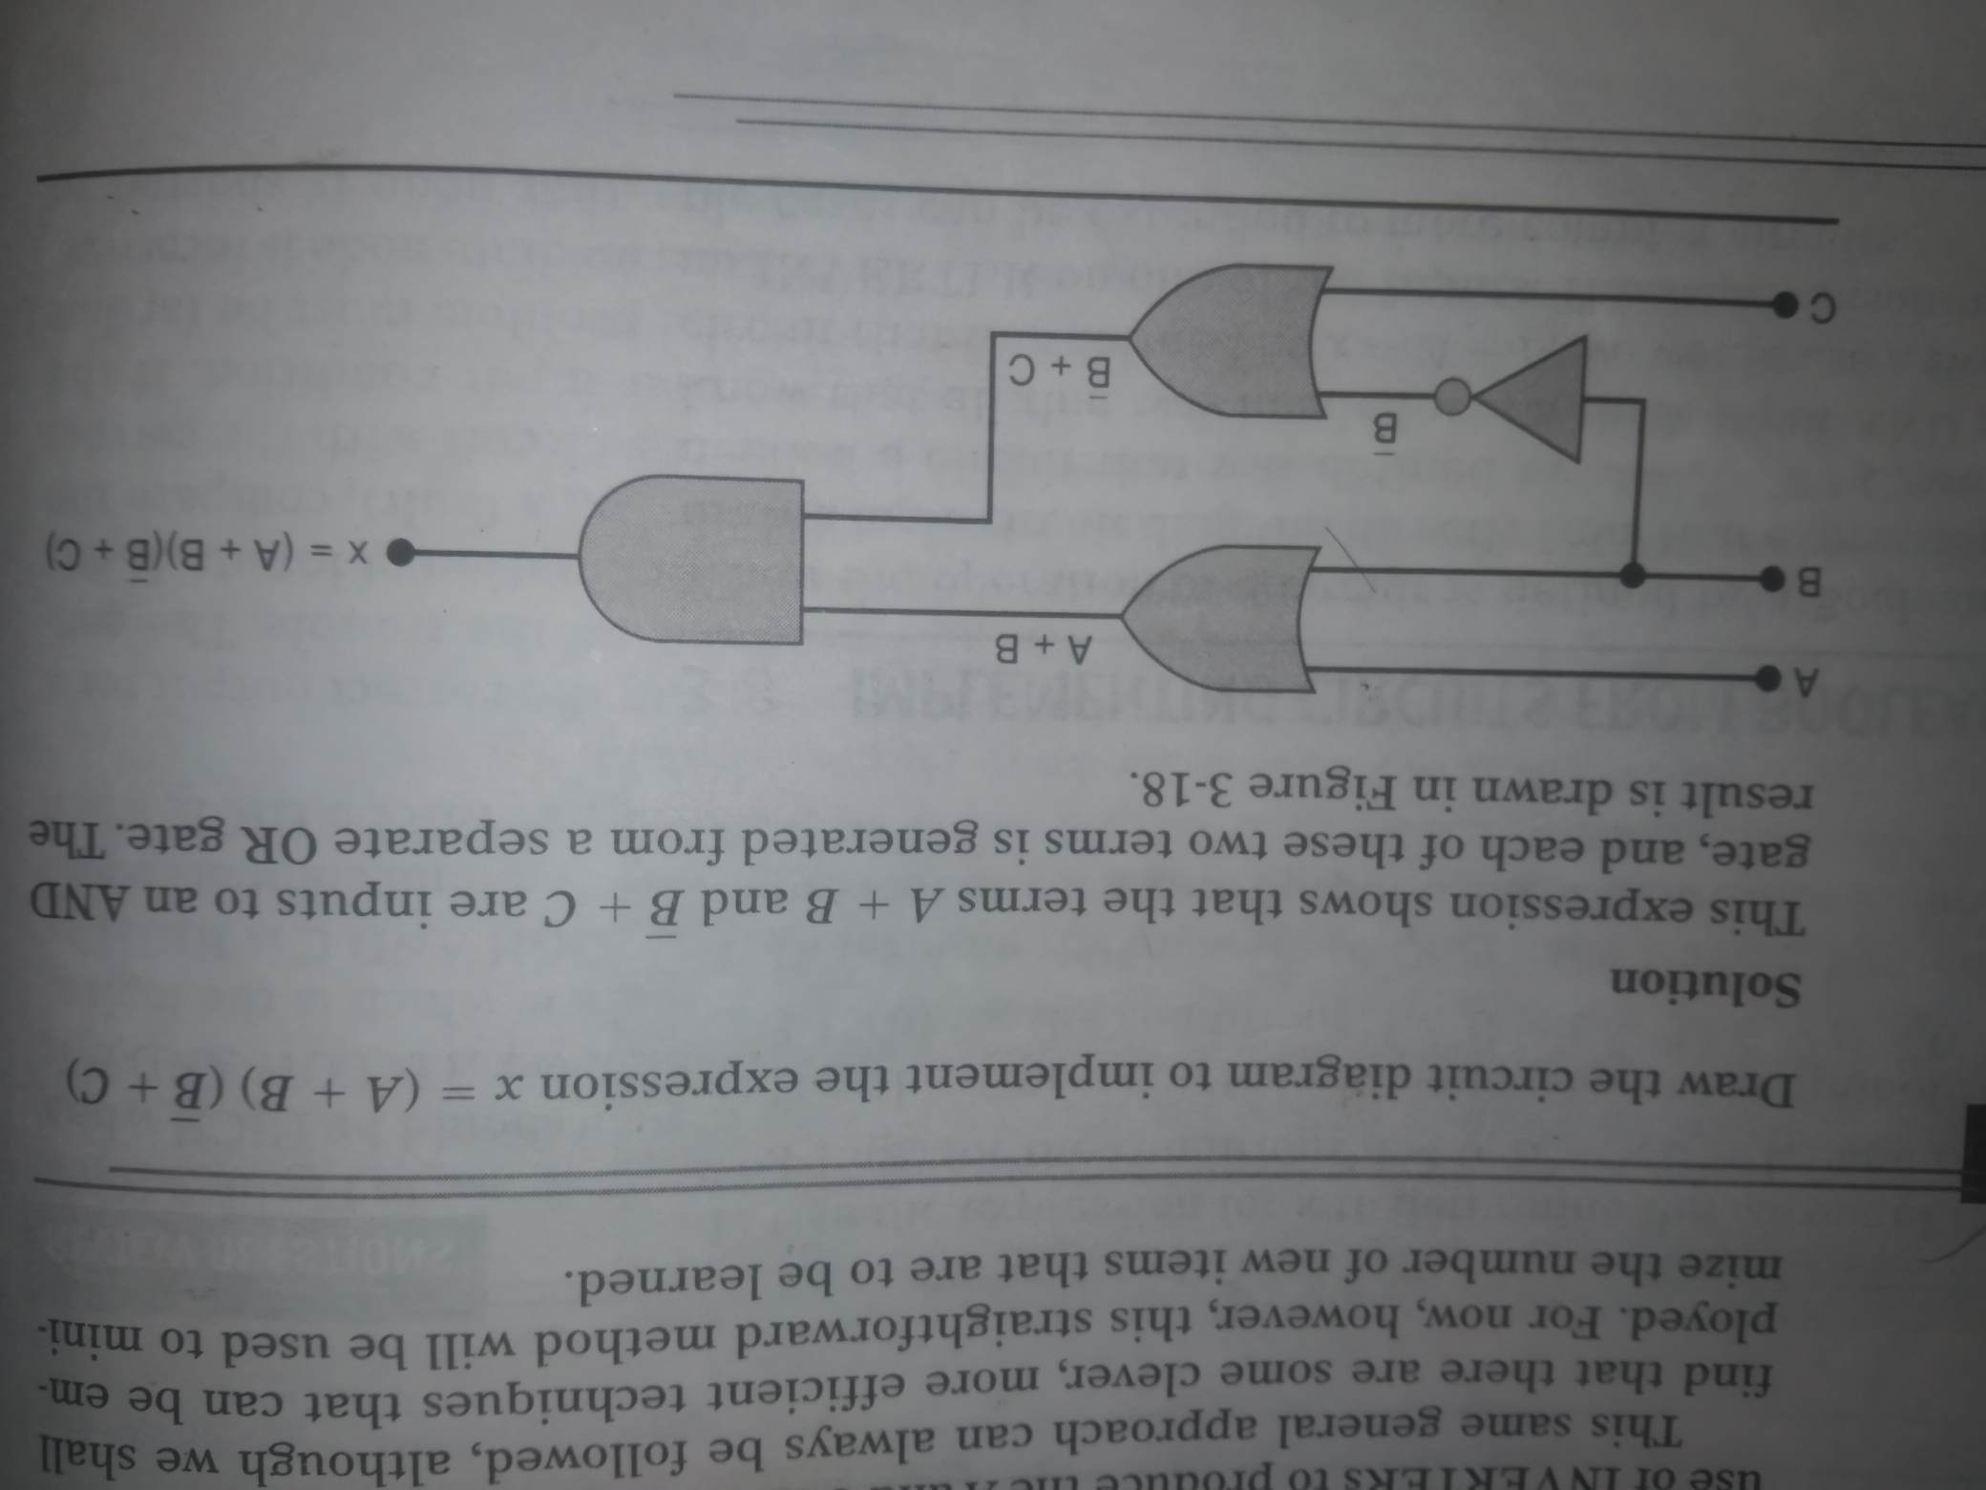

Example
Draw the circuit diagram to implement the expression
$$x=\left(A+B\right)\left(\overline{B}+C\right)$$

Slide 18
Nor gates and nand gates

Slide 19
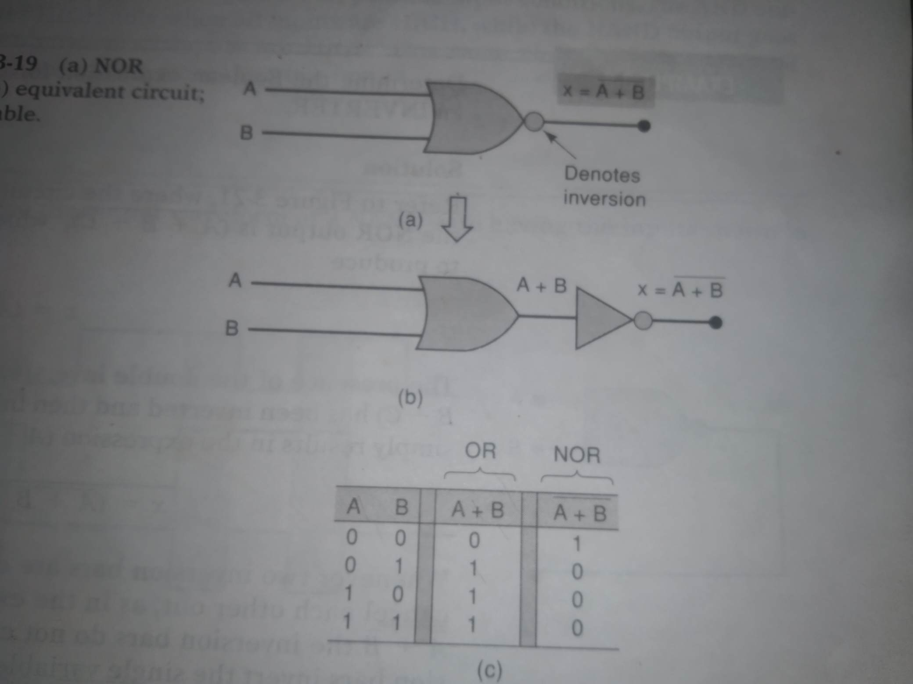
Nor gate

Slide 20
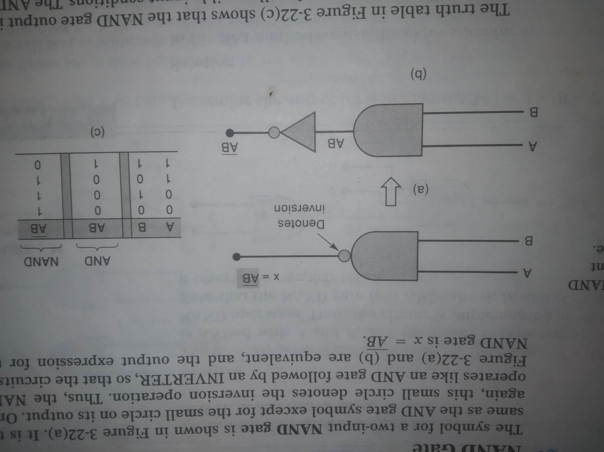
nand gate

Slide 21
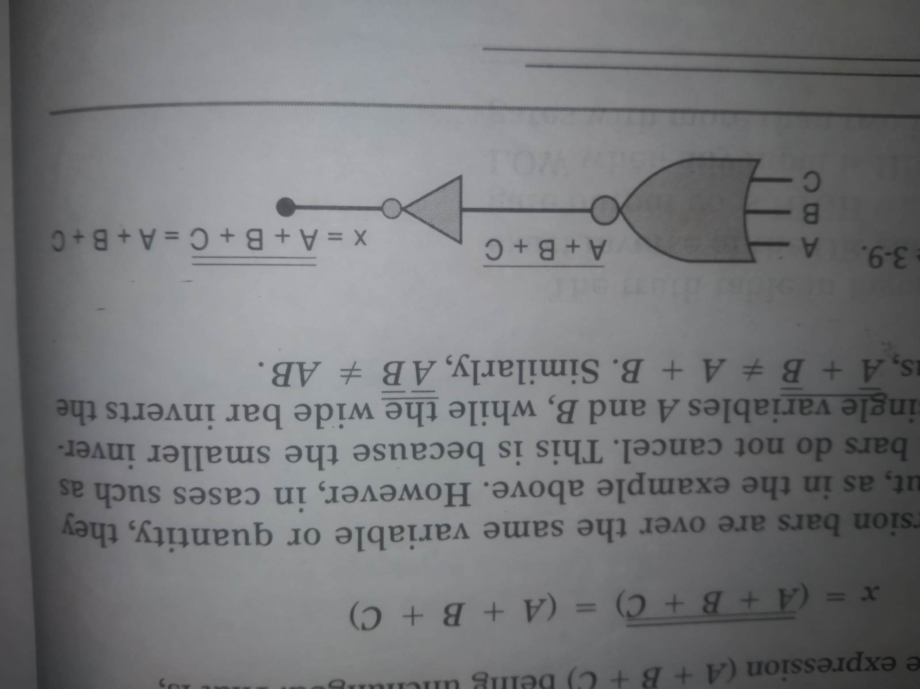

Example
Draw the circuit diagram to implement the expression
$$x=\overset{̿}{A+B+C}$$
$$=A+B+C$$

Slide 22
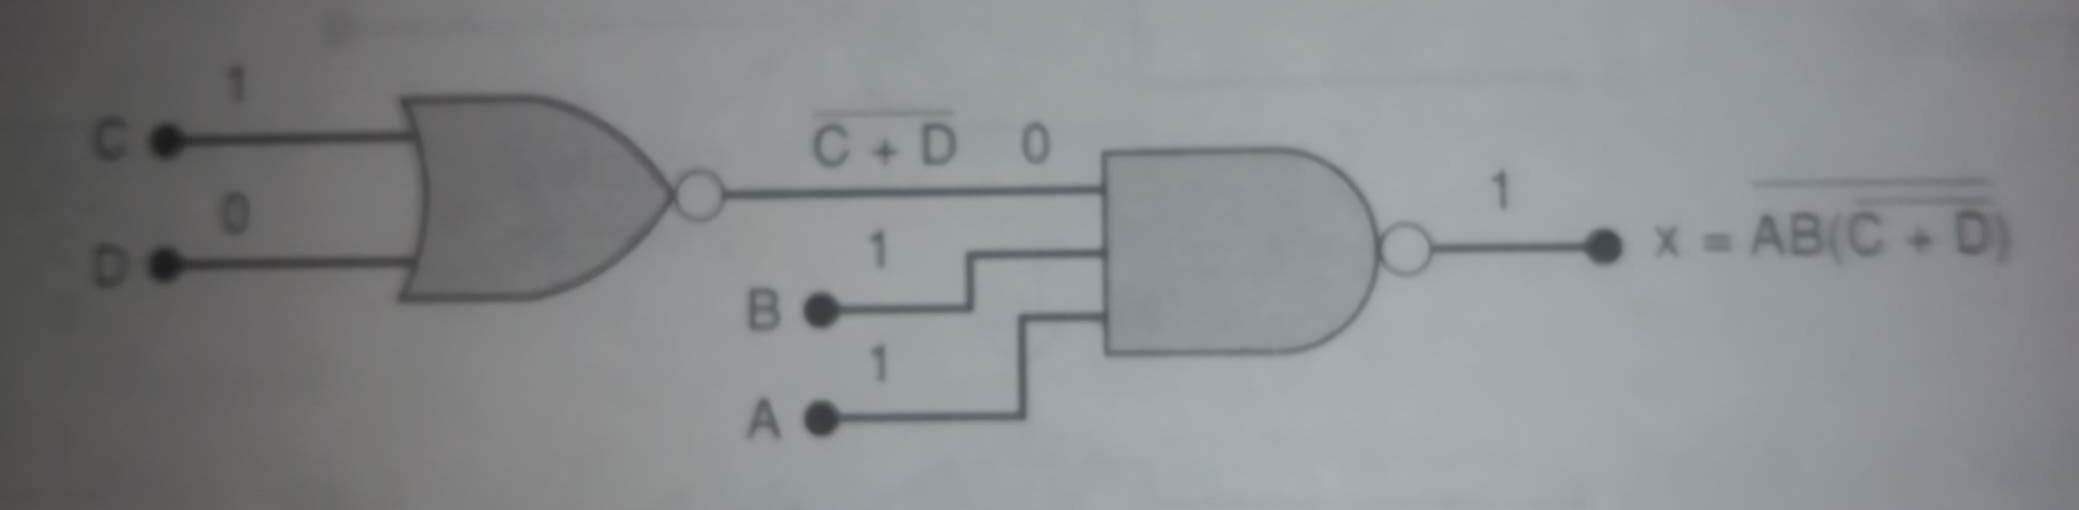

Example
Implement the logic circuit that has the expression
$$x=\overline{AB.(\overline{C+D})}$$

Slide 23
Boolean theorem

Slide 24
Boolean theorem
Single variable theorems
Multivariable theorems

Slide 25
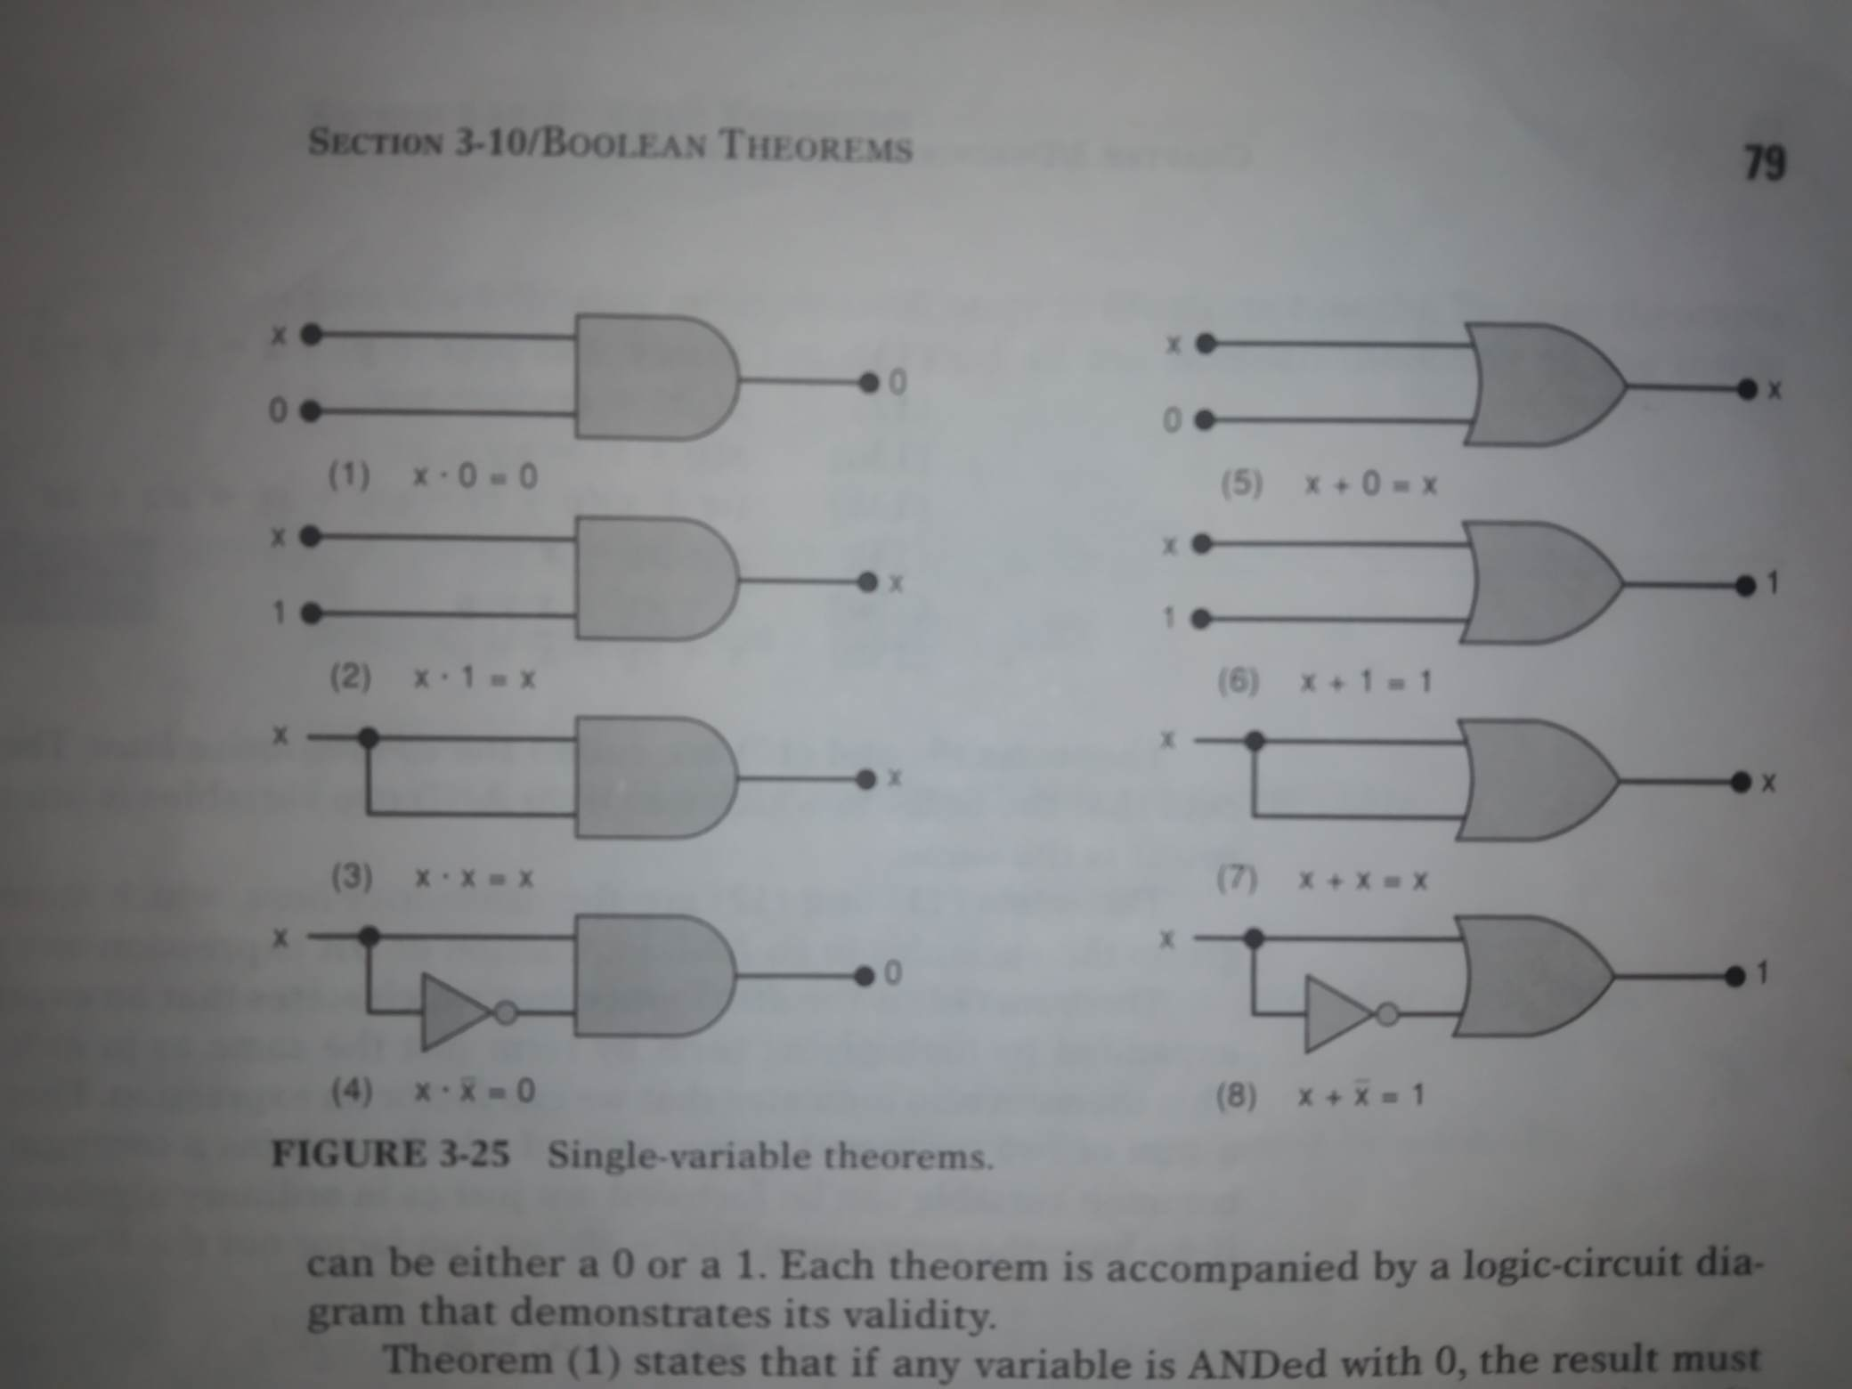
Single variable theorems

Slide 26
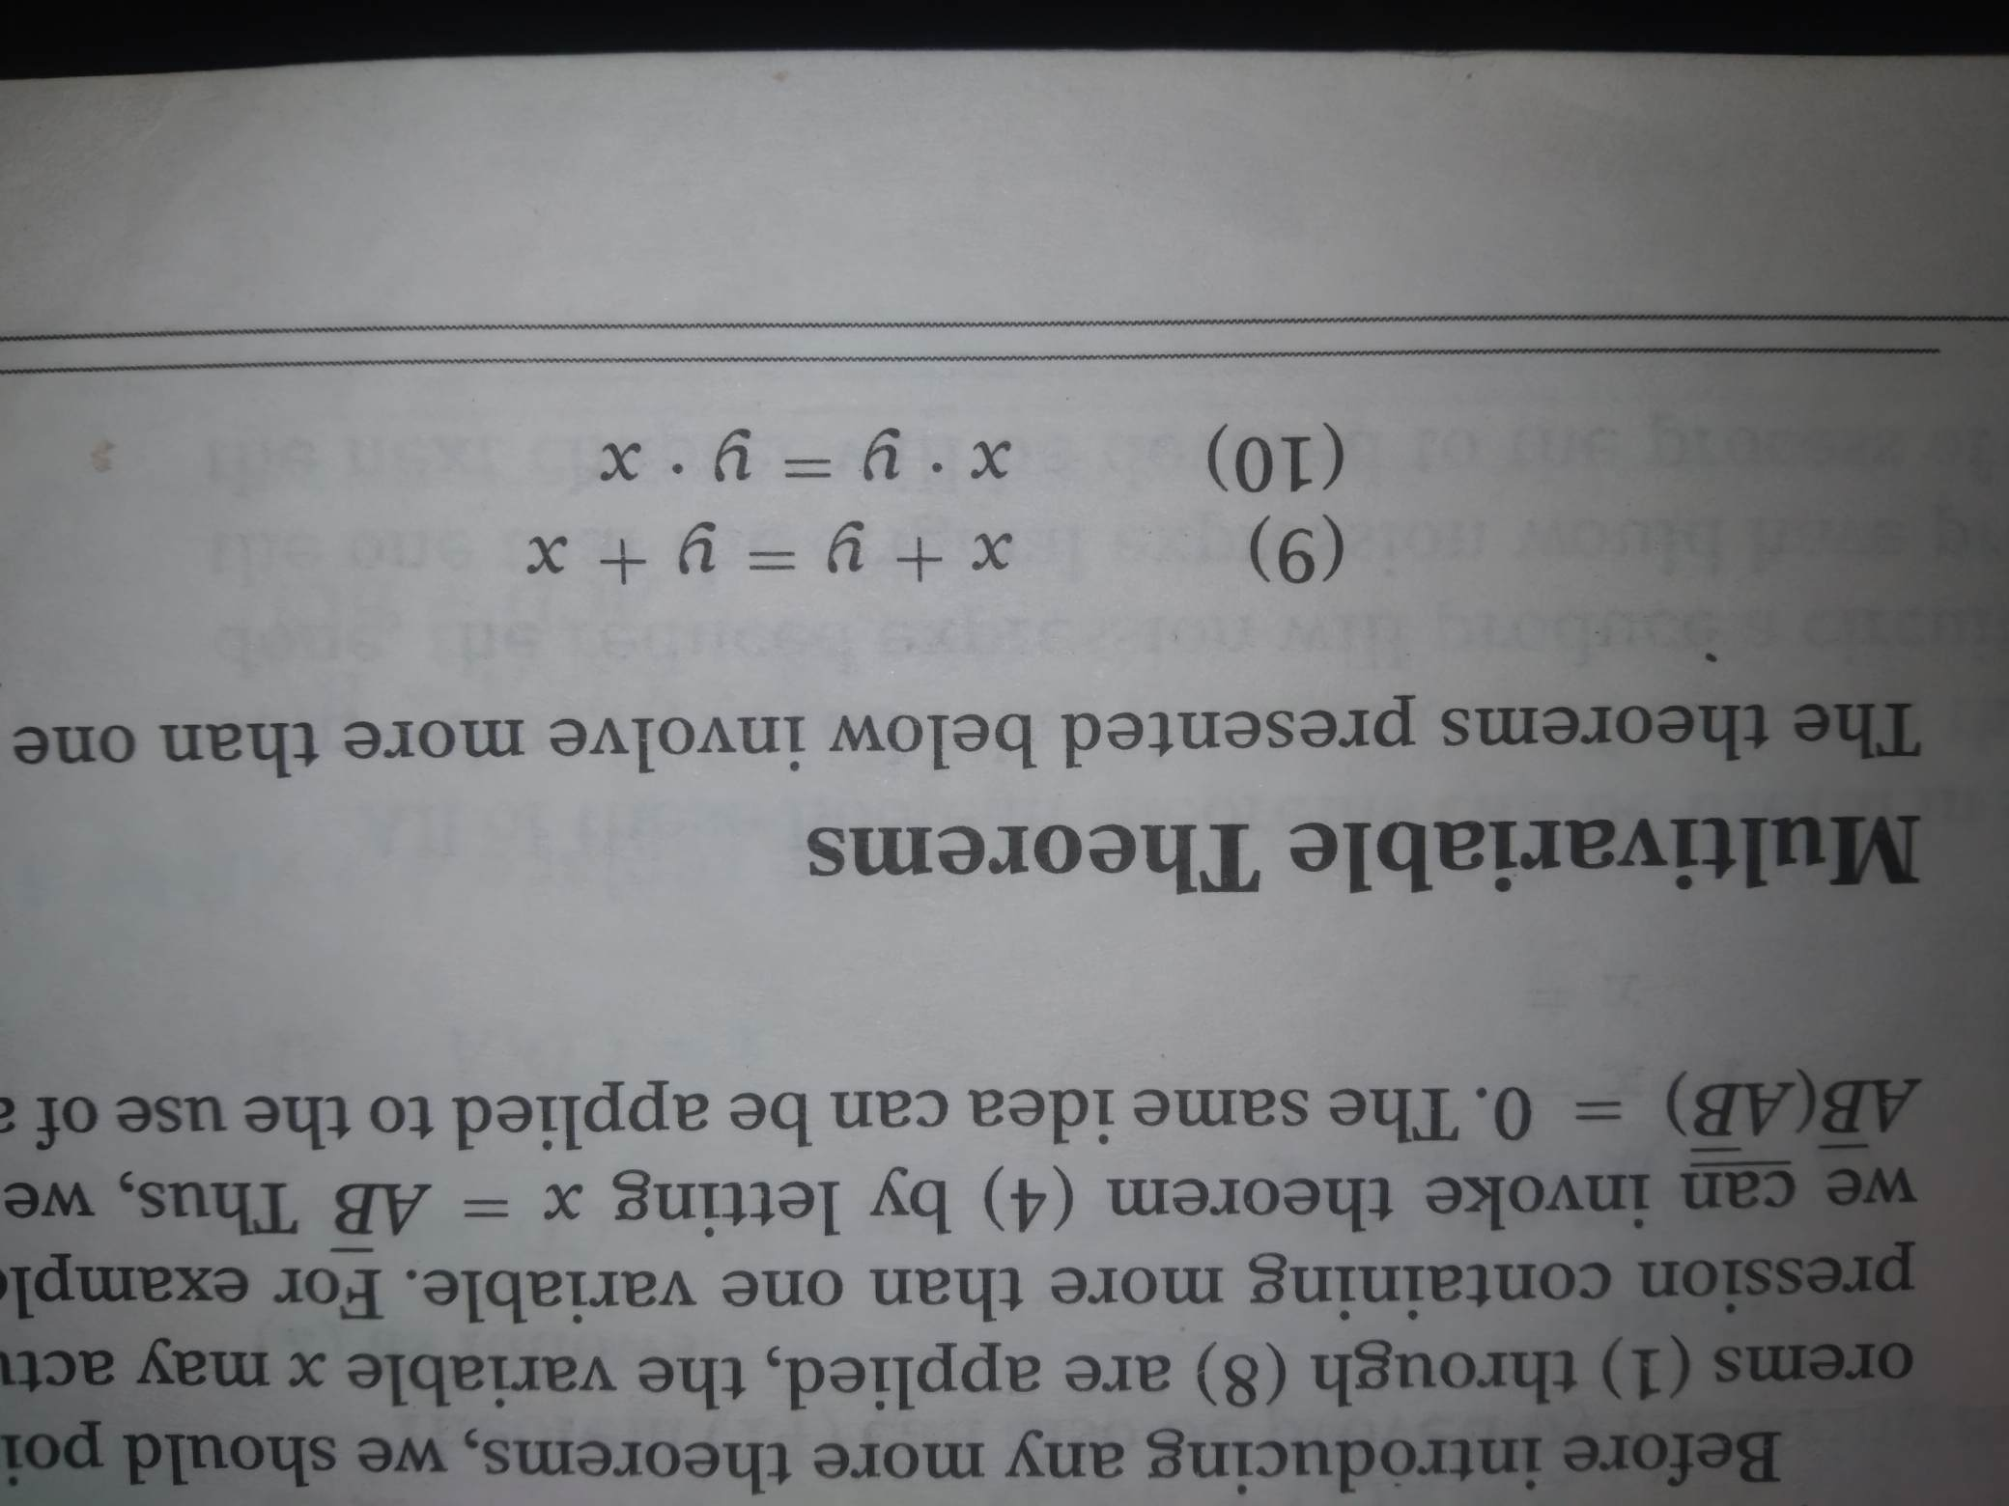
multivariable theorems Commutative laws

Slide 27
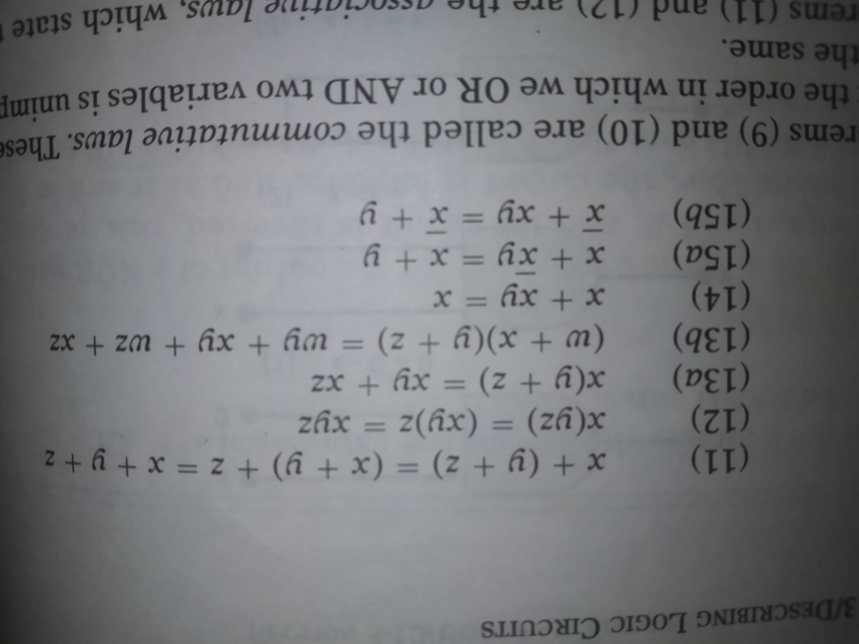
multivariable theorems
11-12. Associative laws
13. Distributive law

Slide 28

14. $x+xy=x$
x | y | xy | x+xy
0 | 0 | 0 | 0
0 | 1 | 0 | 0
1 | 0 | 0 | 1
1 | 1 | 1 | 1

Slide 29
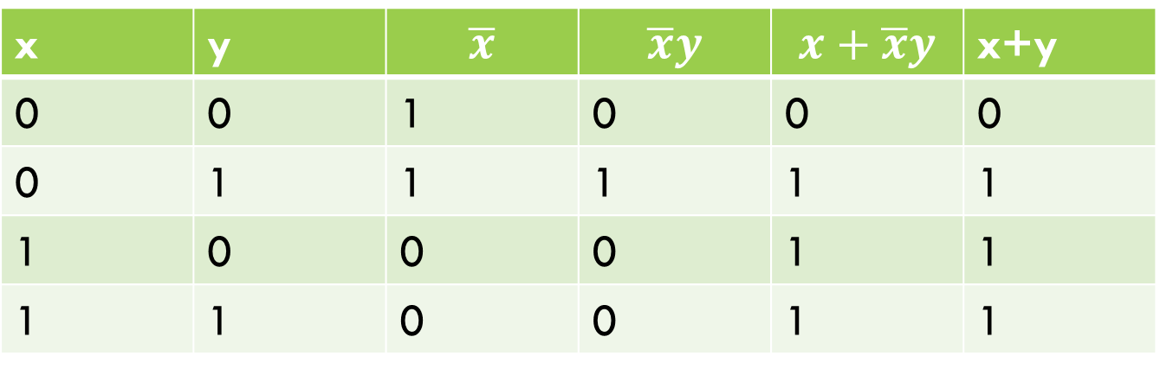

15. (a) $x+\overline{x}y=x+y$
x | y | $$\overline{x}$$ | $$\overline{x}y$$ | $$x+\overline{x}y$$ | x+y
0 | 0 | 1 | 0 | 0 | 0
0 | 1 | 1 | 1 | 1 | 1
1 | 0 | 0 | 0 | 1 | 1
1 | 1 | 0 | 0 | 1 | 1

Slide 30
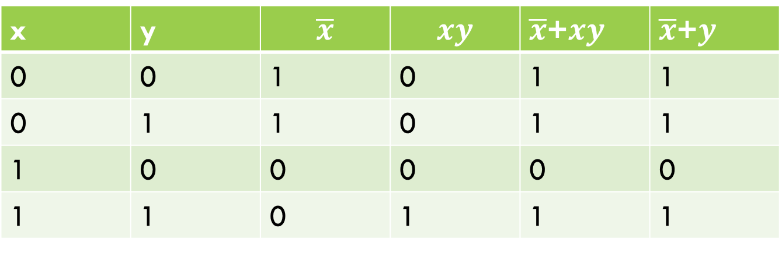

15(B) $\overline{x}$+$xy=\overline{x}\text{+}y$
x | y | $$\overline{x}$$ | $$xy$$ | $\overline{x}$+$xy$ | $\overline{x}$+$y$
0 | 0 | 1 | 0 | 1 | 1
0 | 1 | 1 | 0 | 1 | 1
1 | 0 | 0 | 0 | 0 | 0
1 | 1 | 0 | 1 | 1 | 1

Slide 31

Simplify the following expression
$y=A\overline{B}D+A\overline{B}\overline{D}$
$x=ACD+\overline{A}BCD$

Slide 32
Demorgan’s theorem

Slide 33

Demorgan’s theorem
Demorgan’s theorems (two theorems) are extremely useful in simplifying expressions in which a product or sum of variables is inverted. The two theorems are:
$\overline{x+y}=\overline{x} . \overline{y}$
$\overline{x . y}=\overline{x} +\overline{y}$

Slide 34

Simplify the expression
$$z=\overline{\left(\overline{A}+C\right). (B+\overline{D})}$$
$$=\overline{(\overline{A}+C)}+(\overline{B+\overline{D} })$$
$$=\left(\overset{̿}{A}. \overline{C}\right)+(\overline{B}. \overset{̿}{D})$$
$$=A\overline{C}+\overline{B}D$$

Slide 35
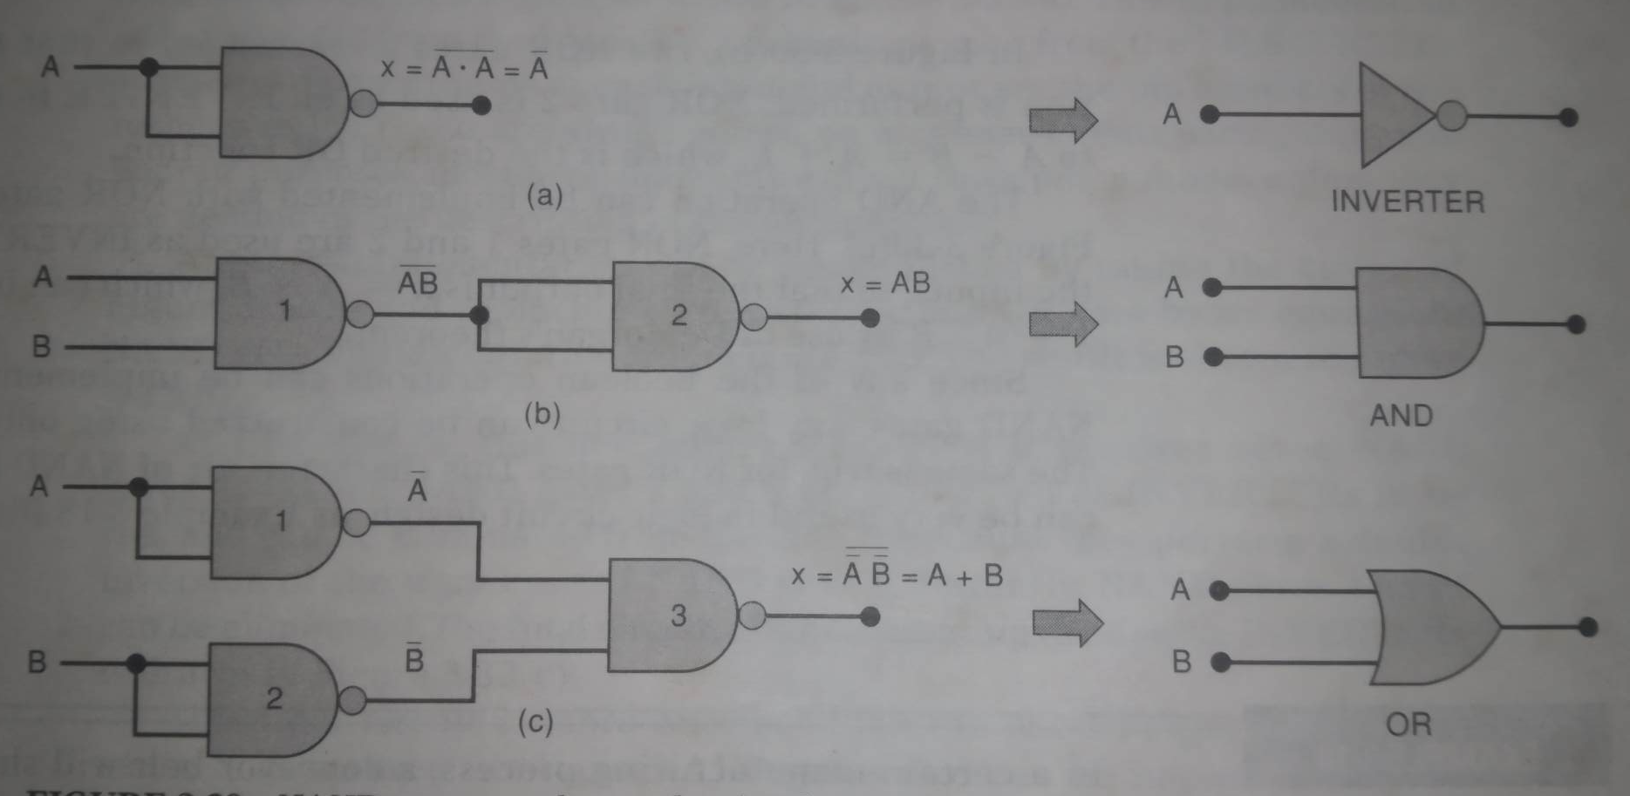
Universality of nand gates and nor gates

Slide 36
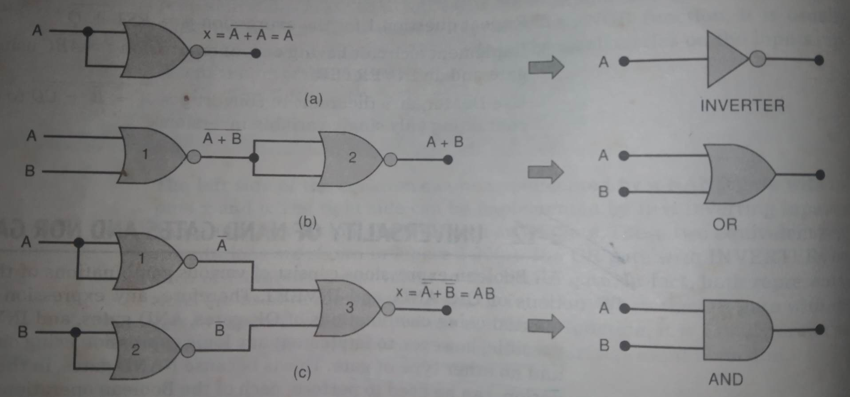
Universality of nand gates and nor gates

Slide 37
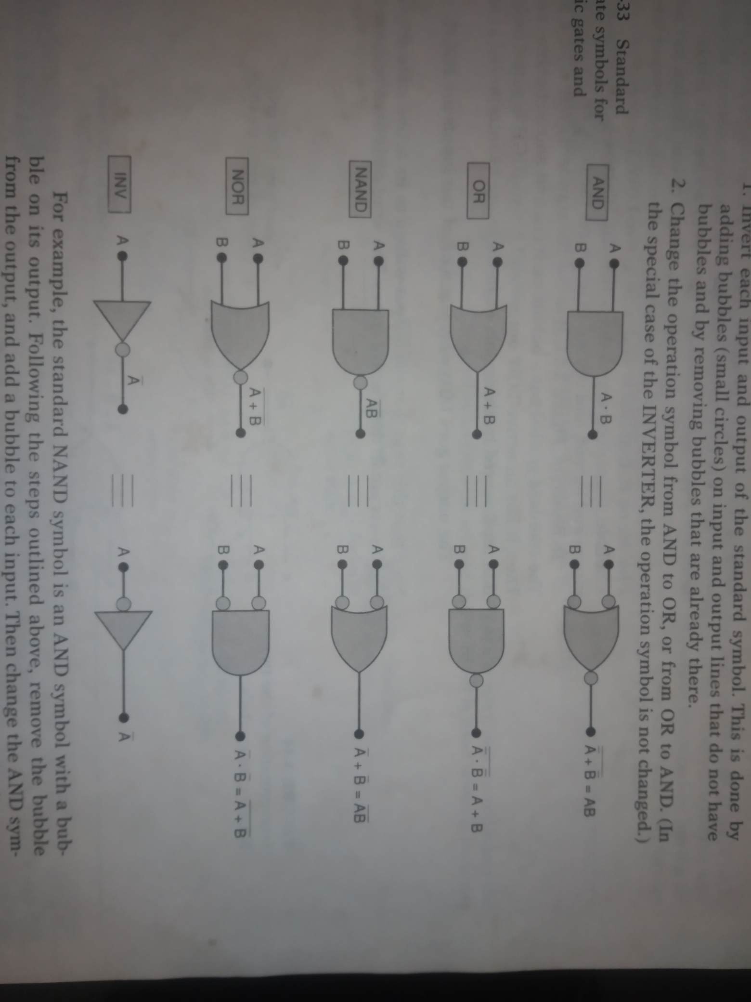
Alternate logic gate representation

